Slide 1

CX Journey Management Overview
2020 Fall WTWY Annual Gala : Proposal for Engaging prospective audience

Slide 2




PROJECT TEAM
Andrew
Role A
Ganesh
Role B
Navish
Role C
Zach
Role D
2019 WomenTechWomenYes (WTWY) Annual Gala, NYC
Notes:
(Team)
Introductory sound-bite. Hi Everyone! At the outset, on our team’s behalf, let me express our thanks to the WTWY for an opportunity to partner with you on this endeavor. We believe Diversity in the technical workforce at all levels enhances collective intelligence and innovation. An information-based society thrives with a vibrant intellectual ecosystem. So, we are really excited about the possibilities and how we help you accelerate progress on your mission.
Without further adieu, let me briefly introduce you our team members.
Andrew
Navish
Zach

Slide 3
AGENDA
Executive Summary : Insights & Recommendation
Key Considerations: Scope, Data & Assumptions
Macro-View of the New York MTA service areas
Snapshot #1 + commentary
Snapshot # 2 + commentary
Snapshot #3 & commentary
Wrap-up (bring it home!) ** Next steps & reco **
2019 WomenTechWomenYes (WTWY) Annual Gala, NYC
Notes:
(Ganesh)

Slide 4


EXECUTIVE SUMMARY
INSIGHT
Low volatility in the rankings, at the top, in terms of MTA commuter traffic despite the Pandemic
Lower Manhattan stations index highly both in traffic and qualified opportunity
A deployment strategy focused on the Manhattan cluster of stations will both help maximize reach and allow for the opportunity to be optimize composition of street teams
RECOMMENDATION
Focus on 7 stations : 34th St.-Penn, 34th St.-Herald Square, Grand Central-42nd St., 14 ST-Union Square, 42nd ST-Port Authority, 23rd St., Fulton St.
Optimal to have street teams deployed to engage target audience during key word-related commute hours during the day
2019 WomenTechWomenYes (WTWY) Annual Gala, NYC
Notes:
(Navish)
OPPORTUNITY
We see a real opportunity to increase awareness/reach among the target audience of technology professionals and drive sign-ups for the upcoming annual gala by strategically deploying smaller teams to 10 stations in the city to reach over 60% of the targets

Slide 5
SCOPE, DATA & ASSUMPTIONS
SCOPE
DATA SOURCES
ASSUMPTIONS
Develop an optimized recommendation for WTWY International to help drive awareness and increase sign-ups for upcoming Fall 2020 WTWY Gala
Gather insights on average daily commuter traffic on the MTA network
Identify a small group of stations that drive a significant share of traffic (MTA Hot Spots)
Recommend an approach to maximize outcomes in the lead-up to the Fall 2020 Gala
Jointly collaborate and align on action plan and expectations around outcomes
Discuss and document learnings that can be leveraged for future efforts
MTA Turnstile Data¹
Geo Location Data² (for stations within the MTA network)
The Fall 2020 Gala is assumed to be an online event
To maximize our ability to reach the target audience (tech enthusiasts), we limited our analysis to focus on key work-related commute hours
Based on high density commuter traffic and geographic proximity, the analysis was limited to Manhattan borough
KEY CONSIDERATIONS
¹ Source: http://web.mta.info/developers/turnstile.html (MTA Turnstile Data)
² Source: http://web.mta.info/developers/data/nyct/subway/Stations.csv (Geo Location Data)
2019 WomenTechWomenYes (WTWY) Annual Gala, NYC
Notes:
(Navish)

Slide 6
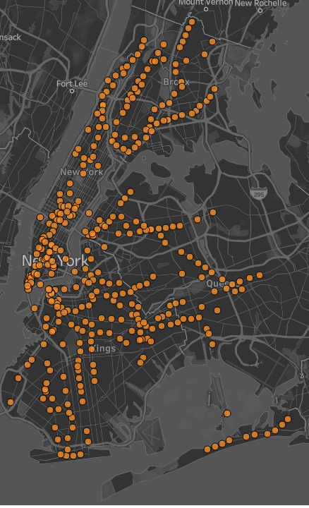
New York City MTA : Key Stats
2.3M+
Riders served on average each day
Includes daily commuters and visitors to NYC
379
Stations
Oldest and largest public transportation system in the world (in terms of number of stations)
4
Serves the 4 boroughs
The New York subway system operates in Manhattan, Queens, Brooklyn, and the Bronx. It never leaves New York City.
2019 WomenTechWomenYes (WTWY) Annual Gala, NYC
Notes:
(Navish)

Slide 7
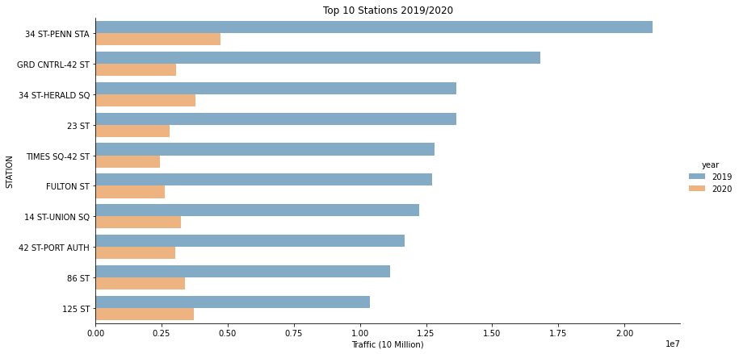
No significant change to rankings based on commuter traffic between 2019 and 2020
2019 WomenTechWomenYes (WTWY) Annual Gala, NYC
Notes:
Zach will own this slide and add speaker notes

Slide 8
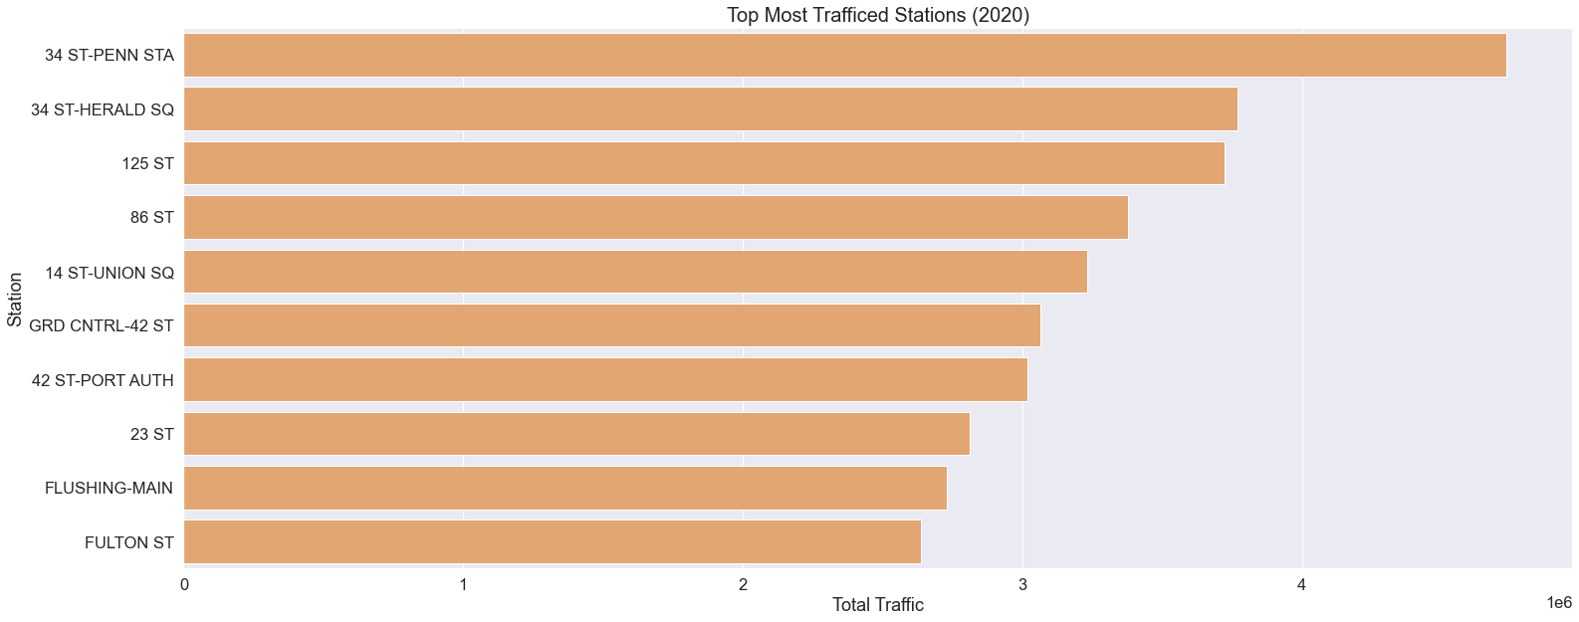
17% of commuter traffic is captured by Top 10 Stations
2019 WomenTechWomenYes (WTWY) Annual Gala, NYC
Notes:
Zach
We grouped stations and added the total of entries and exists …

Slide 9
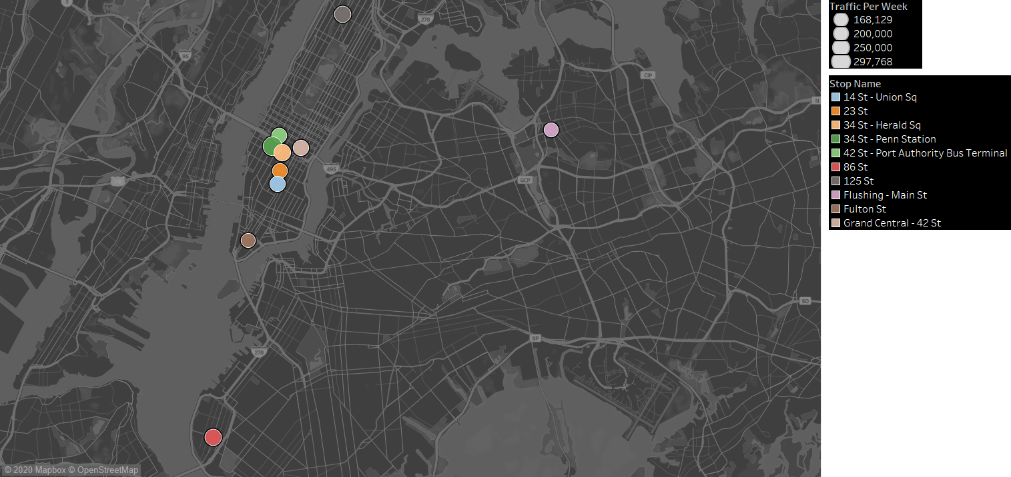
Majority of these stations are clustered around Manhattan, below Central Park
2019 WomenTechWomenYes (WTWY) Annual Gala, NYC
Notes:
(Andrew)
Talking pts.:
Majority of the Hot-Spot stations are clustered around Manhattan, below Central Park
The remaining few Hot-Spot stations are spread across the other 3 boroughs
Our recommendations are based of our analysis of the Manhattan
-Some of them are clustered around transfer stations

Slide 10
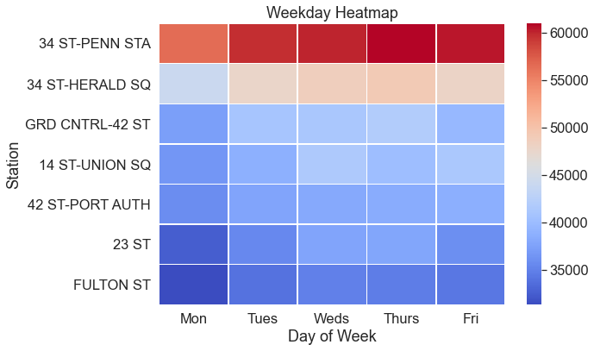
Daily traffic patterns at ‘Hot Spot’ MTA stations
2019 WomenTechWomenYes (WTWY) Annual Gala, NYC
Notes:
(Andrew)
What percentage of traffic goes thru these 7 stations? What is the targetable audience based on some assumptions on traffic patterns during weekdays?
Analysis focused on weekday commuter traffic
Rationale for focusing on weekdays – data supported that the traffic volumes were substantially lower during weekends and further, it was assumed that weekdays were the best time to engage with the target audience (tech professionals)

Slide 11
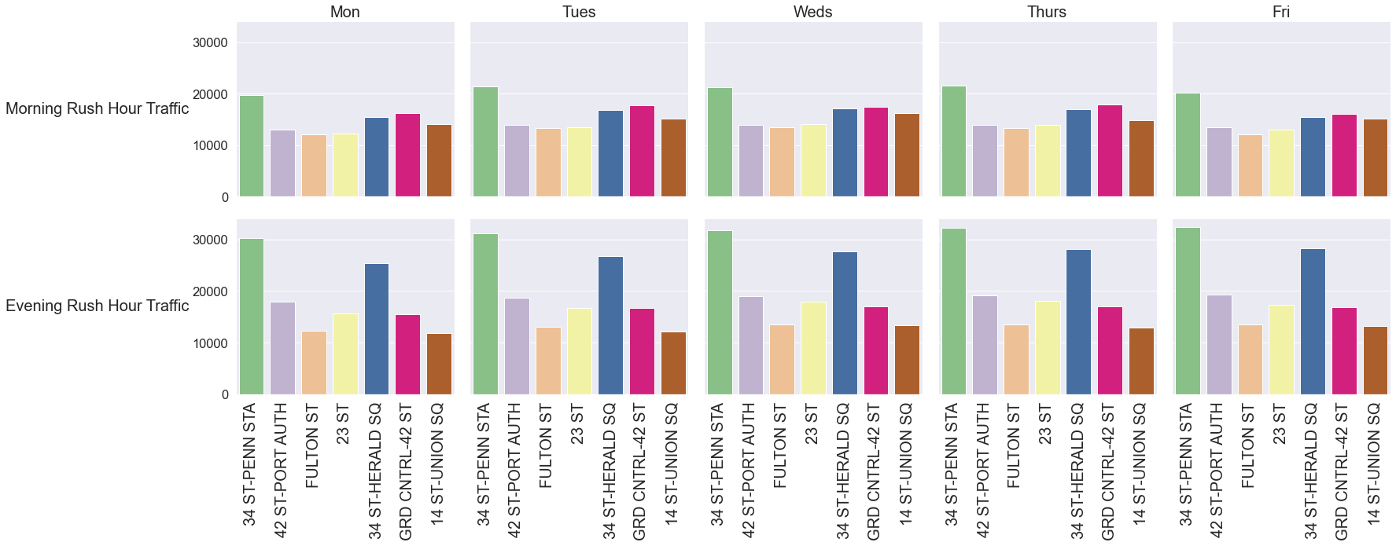
WIP
Focusing on evening commuter traffic hours will yield the best results
2019 WomenTechWomenYes (WTWY) Annual Gala, NYC
Notes:
(Andrew)
What percentage of traffic goes thru these 7 stations? What is the targetable audience based on some assumptions on traffic patterns during weekdays?
Which window did we use : 2 – 8hr windows ( 5am-1pm) and (1-8pm)

Slide 12

Recommendation & Opportunities for the future
Where
34 ST Penn Station
34 ST Harold Sq
Grand Central 42 ST
When
Thursday
Evening
What/How?
We see a real opportunity to increase awareness/reach among the target audience of technology professionals and drive sign-ups for the upcoming annual gala by strategically deploying smaller teams to 10 stations in the city to reach over 60% of the targets
Insert Map here
2019 WomenTechWomenYes (WTWY) Annual Gala, NYC
Notes:
(Ganesh)
Email Referrals/ Advocacy
Media Placements partnering with other companies that support the cause
Social Engagement to keep the buzz around future events

Slide 13
Appendix
2019 WomenTechWomenYes (WTWY) Annual Gala, NYC

